Slide 1
Internet Protocols
Tirthankar Ghosh, Ph. D.
Notes:
“Data and Computer Communications”, 9/e, by William Stallings, Chapter 18 “Internet Protocols”.

Slide 2
Internet
Internet
an interconnected set of networks where each of the constituent networks retains its identity
end systems
devices attached to a network
intermediate systems
provide a communications path and perform the necessary relaying and routing functions
bridges
acts as a relay of frames between similar networks
routers
routes packets between potentially different networks
Notes:
An interconnected set of networks, from a user's point of view, may appear simply as a larger network. However, if each of the constituent networks retains its identity and special mechanisms are needed for communicating across multiple networks, then the entire configuration is often referred to as an internet.
Each constituent network in an internet supports communication among the devices attached to that network; these devices are referred to as end systems (ESs). In addition, networks are connected by devices referred to in the ISO documents as intermediate systems (ISs). Intermediate systems provide a communications path and perform the necessary relaying and routing functions so that data can be exchanged between devices attached to different networks in the internet.
Two types of ISs of particular interest are bridges and routers. The differences between them have to do with the types of protocols used for the internetworking logic. In essence, a bridge operates at layer 2 of the open systems interconnection (OSI) seven-layer architecture and acts as a relay of frames between similar networks; bridges are discussed in Stallings DCC9e Chapter 15. A router operates at layer 3 of the OSI architecture and routes packets between potentially different networks. Both the bridge and the router assume that the same upper-layer protocols are in use.
We begin our examination of internetworking with a discussion of the basic principles of internetworking. We then examine the most important architectural approach to internetworking: the connectionless router.

Slide 3
Internetworking Terms
Notes:
Packet-switching and packet-broadcasting networks grew out of a need to allow the computer user to have access to resources beyond that available in a single system. In a similar fashion, the resources of a single network are often inadequate to meet users' needs. Because the networks that might be of interest exhibit so many differences, it is impractical to consider merging them into a single network. Rather, what is needed is the ability to interconnect various networks so that any two stations on any of the constituent networks can communicate.
Stallings Dcc9e Table 18.1 lists some commonly used terms relating to the interconnection of networks, or internetworking.

Slide 4
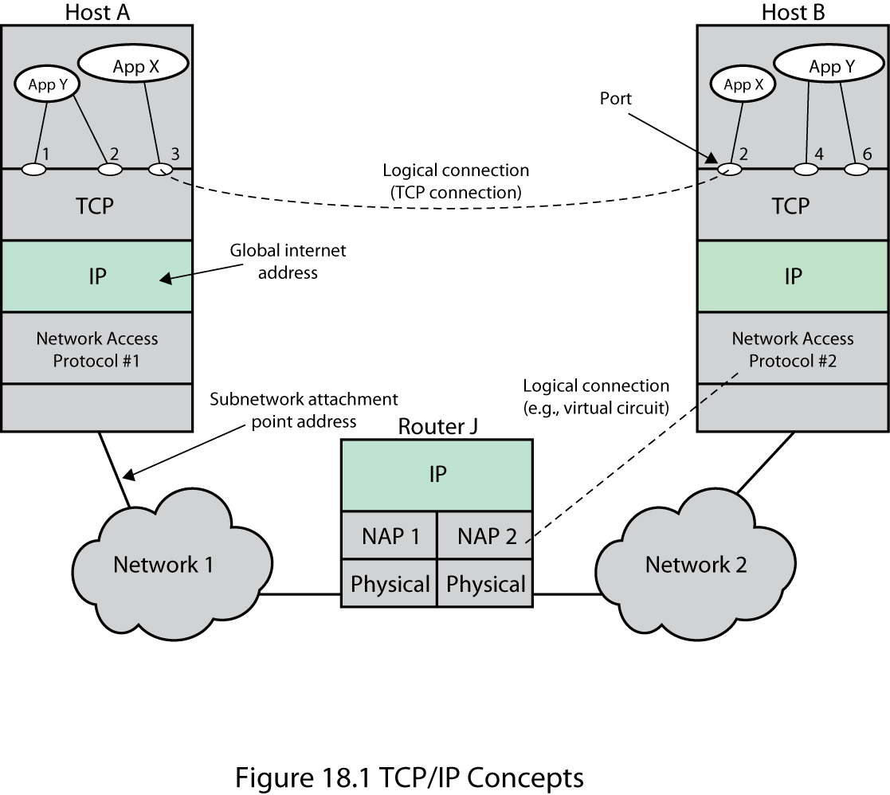
TCP/IP Concepts
Notes:
The overall requirements for an internetworking facility are as follows (we refer to Stallings DCC9e Figure 18.1, which repeats Figure 2.4, as an example throughout):
1. Provide a link between networks. At minimum, a physical and link control connection is needed. (Router J has physical links to N1 and N2, and on each link there is a data link protocol.)
2. Provide for the routing and delivery of data between processes on different networks. (Application X on host A exchanges data with application X on host B.)
3. Provide an accounting service that keeps track of the use of the various networks and routers and maintains status information.
4. Provide the services just listed in such a way as not to require modifications to the networking architecture of any of the constituent networks.

Slide 5
Differences in Networks
addressing schemes
maximum packet size
network access mechanisms
timeouts
error recovery
status reporting
routing techniques
user access control
connection, connectionless
Notes:
This means that the internetworking facility must accommodate a number of differences among networks. These include
—Different addressing schemes: The networks may use different endpoint names and addresses and directory maintenance schemes. Some form of global network addressing must be provided, as well as a directory service. (Hosts A and B and router J have globally unique IP addresses.)
—Different maximum packet size: Packets from one network may have to be broken up into smaller pieces for another. This process is referred to as fragmentation. (N1 and N2 may set different upper limits on packet sizes.)
—Different network access mechanisms: The network access mechanism between station and network may be different for stations on different networks. (For example, N1 may be a frame relay network and N2 an Ethernet network.)
—Different timeouts: Typically, a connection-oriented transport service will await an acknowledgment until a timeout expires, at which time it will retransmit its block of data. In general, longer times are required for successful delivery across multiple networks. Internetwork timing procedures must allow successful transmission that avoids unnecessary retransmissions.
—Error recovery: Network procedures may provide anything from no error recovery up to reliable end-to-end (within the network) service. The internetwork service should not depend on nor be interfered with by the nature of the individual network's error recovery capability.
—Status reporting: Different networks report status and performance differently. Yet it must be possible for the internetworking facility to provide such information on internetworking activity to interested and authorized processes.
—Routing techniques: Intranetwork routing may depend on fault detection and congestion control techniques peculiar to each network. The internetworking facility must be able to coordinate these to route data adaptively between stations on different networks.
—User access control: Each network will have its own user access control technique (authorization for use of the network). These must be invoked by the internetwork facility as needed. Further, a separate internetwork access control technique may be required.
—Connection, connectionless: Individual networks may provide connection-oriented (e.g., virtual circuit) or connectionless (datagram) service. It may be desirable for the internetwork service not to depend on the nature of the connection service of the individual networks.
The Internet Protocol (IP) meets some of these requirements. Others require additional control and application software, as we shall see in this chapter and the next.

Slide 6
Connectionless Operation
Internetworking involves connectionless operation at the level of the Internet Protocol (IP)
IP
initially developed for the DARPA internet project
protocol is needed to access a particular network
Notes:
In virtually all implementation, internetworking involves connectionless operation at the level of the Internet Protocol. Whereas connection-oriented operation corresponds to the virtual circuit mechanism of a packet-switching network (Stallings DCC9e Figure 10.10), connectionless-mode operation corresponds to the datagram mechanism of a packet-switching network (Stallings DCC9e Figure 10.9). Each network protocol data unit is treated independently and routed from source ES to destination ES through a series of routers and networks. For each data unit transmitted by A, A makes a decision as to which router should receive the data unit. The data unit hops across the internet from one router to the next until it reaches the destination network. At each router, a routing decision is made (independently for each data unit) concerning the next hop. Thus, different data units may travel different routes between source and destination ES.
All ESs and all routers share a common network-layer protocol known generically as the Internet Protocol. An Internet Protocol (IP) was initially developed for the DARPA internet project and published as RFC 791 and has become an Internet Standard. Below this Internet Protocol, a protocol is needed to access a particular network.

Slide 7
Connectionless Internetworking
Connectionless internet facility is flexible
IP provides a connectionless service between end systems.
Advantages:
is flexible
can be made robust
does not impose unnecessary overhead
Notes:
Operation of a Connectionless Internetworking Scheme
IP provides a connectionless, or datagram, service between end systems. There are a number of advantages to this approach:
A connectionless internet facility is flexible. It can deal with a variety of networks, some of which are themselves connectionless. In essence, IP requires very little from the constituent networks.
A connectionless internet service can be made highly robust. This is basically the same argument made for a datagram network service versus a virtual circuit service. For a further discussion, see Stallings DCC9e Section 10.5.
A connectionless internet service is best for connectionless transport protocols, because it does not impose unnecessary overhead.

Slide 8
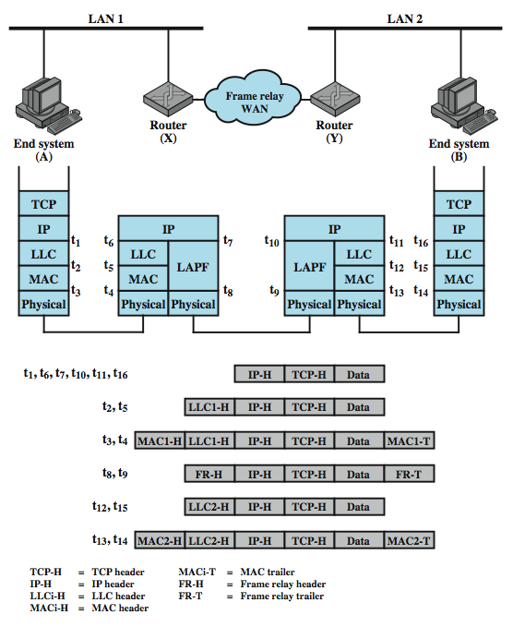
IP Operation
Notes:
Stallings DCC9e Figure 18.2 depicts a typical example using IP, in which two LANs are interconnected by a frame relay WAN. The figure depicts the operation of the Internet Protocol for data exchange between host A on one LAN (network 1) and host B on another LAN (network 2) through the WAN. The figure shows the protocol architecture and format of the data unit at each stage. The end systems and routers must all share a common Internet Protocol. In addition, the end systems must share the same protocols above IP. The intermediate routers need only implement up through IP.
The IP at A receives blocks of data to be sent to B from a higher layers of software in A (e.g., TCP or UDP). IP attaches a header (at time t1) specifying, among other things, the global internet address of B. That address is logically in two parts: network identifier and end system identifier. The combination of IP header and upper-level data is called an Internet Protocol data unit (PDU), or simply a datagram. The datagram is then encapsulated with the LAN protocol (LLC header at t2; MAC header and trailer at t3) and sent to the router, which strips off the LAN fields to read the IP header (t6). The router then encapsulates the datagram with the frame relay protocol fields (t8) and transmits it across the WAN to another router. This router strips off the frame relay fields and recovers the datagram, which it then wraps in LAN fields appropriate to LAN 2 and sends it to B.
Let us now look at this example in more detail. End system A has a datagram to transmit to end system B; the datagram includes the internet address of B. The IP module in A recognizes that the destination (B) is on another network. So the first step is to send the data to a router, in this case router X. To do this, IP passes the datagram down to the next lower layer (in this case LLC) with instructions to send it to router X. LLC in turn passes this information down to the MAC layer, which inserts the MAC-level address of router X into the MAC header. Thus, the block of data transmitted onto LAN 1 includes data from a layer or layers above TCP, plus a TCP header, an IP header, an LLC header, and a MAC header and trailer (time t3 in Figure 18.2).
Next, the packet travels through network 1 to router X. The router removes MAC and LLC fields and analyzes the IP header to determine the ultimate destination of the data, in this case B. The router must now make a routing decision. There are three possibilities:
1. The destination station B is connected directly to one of the networks to which the router is attached. If so, the router sends the datagram directly to the destination.
2. To reach the destination, one or more additional routers must be traversed. If so, a routing decision must be made: To which router should the datagram be sent? In both cases 1 and 2, the IP module in the router sends the datagram down to the next lower layer with the destination network address. Please note that we are speaking here of a lower-layer address that refers to this network.
3. The router does not know the destination address. In this case, the router returns an error message to the source of the datagram.
In this example, the data must pass through router Y before reaching the destination. So router X constructs a new frame by appending a frame relay (LAPF) header and trailer to the IP datagram. The frame relay header indicates a logical connection to router Y When this frame arrives at router Y, the frame header and trailer are stripped off. The router determines that this IP data unit is destined for B, which is connected directly to a network to which this router is attached. The router therefore creates a frame with a layer-2 destination address of B and sends it out onto LAN 2. The data finally arrive at B, where the LAN and IP headers can be stripped off.
At each router, before the data can be forwarded, the router may need to fragment the datagram to accommodate a smaller maximum packet size limitation on the outgoing network. If so, the data unit is split into two or more fragments, each of which becomes an independent IP datagram. Each new data unit is wrapped in a lower-layer packet and queued for transmission. The router may also limit the length of its queue for each network to which it attaches so as to avoid having a slow network penalize a faster one. Once the queue limit is reached, additional data units are simply dropped.
The process just described continues through as many routers as it takes for the data unit to reach its destination. As with a router, the destination end system recovers the IP datagram from its network wrapping. If fragmentation has occurred, the IP module in the destination end system buffers the incoming data until the entire original data field can be reassembled. This block of data is then passed to a higher layer in the end system.
This service offered by IP is an unreliable one. That is, IP does not guarantee that all data will be delivered or that the data that are delivered will arrive in the proper order. It is the responsibility of the next higher layer (e.g., TCP) to recover from any errors that occur. This approach provides for a great deal of flexibility.
With the Internet Protocol approach, each unit of data is passed from router to router in an attempt to get from source to destination. Because delivery is not guaranteed, there is no particular reliability requirement on any of the networks. Thus, the protocol will work with any combination of network types. Because the sequence of delivery is not guaranteed, successive data units can follow different paths through the internet. This allows the protocol to react to both congestion and failure in the internet by changing routes.

Slide 9
IP Design Issues
routing
datagram lifetime
fragmentation and reassembly
error control
flow control
Notes:
Design Issues
With that brief sketch of the operation of an IP-controlled internet, we now examine some design issues in greater detail:
Routing
Datagram lifetime
Fragmentation and reassembly
Error control
Flow control

Slide 10
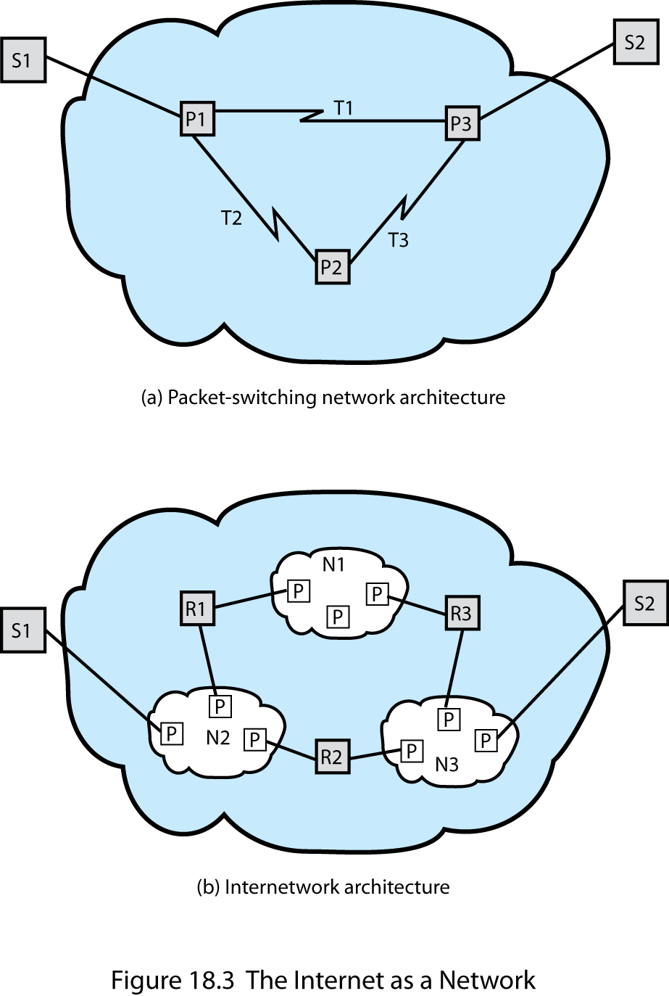
The Internet as a Network
Notes:
Stallings DCC9e Figure 18.3

Slide 11
Routing
ES / routers maintain routing tables
indicate next router to which datagram is sent
source routing
source specifies route to be followed
route recording
static
dynamic
can be useful for security & priority
Notes:
For the purpose of routing, each end system and router maintains a routing table that lists, for each possible destination network, the next router to which the internet datagram should be sent.
The routing table may be static or dynamic. A static table, however, could contain alternate routes if a particular router is unavailable. A dynamic table is more flexible in responding to both error and congestion conditions. In the Internet, for example, when a router goes down, all of its neighbors will send out a status report, allowing other routers and stations to update their routing tables. A similar scheme can be used to control congestion. Congestion control is particularly important because of the mismatch in capacity between local and wide area networks. Stallings DCC9e Chapter 19 discusses routing protocols.
Routing tables may also be used to support other internetworking services, such as security and priority. For example, individual networks might be classified to handle data up to a given security classification. The routing mechanism must assure that data of a given security level are not allowed to pass through networks not cleared to handle such data.
Another routing technique is source routing. The source station specifies the route by including a sequential list of routers in the datagram. This, again, could be useful for security or priority requirements.
Finally, we mention a service related to routing: route recording. To record a route, each router appends its internet address to a list of addresses in the datagram. This feature is useful for testing and debugging purposes.

Slide 12
Internet Protocol (IP) v4
defined in RFC 791
part of TCP/IP suite
two parts
specification of interface with a higher layer
specification of actual protocol format and mechanisms
Notes:
In this section, we look at version 4 of IP, officially defined in RFC 791. Although it is intended that IPv4 will ultimately be replaced by IPv6, it is currently the standard IP used in TCP/IP networks. The Internet Protocol (IP) is part of the TCP/IP suite and is the most widely used internetworking protocol. As with any protocol standard, IP is specified in two parts (see Stallings DCC9e Figure 2.10): The interface with a higher layer (e.g., TCP), specifying the services that IP provides The actual protocol format and mechanisms. In this section, we examine first IP services and then the protocol. This is followed by a discussion of IP address formats. Finally, the Internet Control Message Protocol (ICMP), which is an integral part of IP, is described.

Slide 13
IP Services
Primitives
specifies functions to be performed
form of primitive implementation dependent
Send - request transmission of data unit
Deliver - notify user of arrival of data unit
Parameters
used to pass data and control information
Notes:
The services to be provided across adjacent protocol layers (e.g., between IP and TCP) are expressed in terms of primitives and parameters. A primitive specifies the function to be performed, and the parameters are used to pass data and control information. The actual form of a primitive is implementation dependent. An example is a procedure call.
IP provides two service primitives at the interface to the next higher layer. The Send primitive is used to request transmission of a data unit. The Deliver primitive is used by IP to notify a user of the arrival of a data unit.

Slide 14
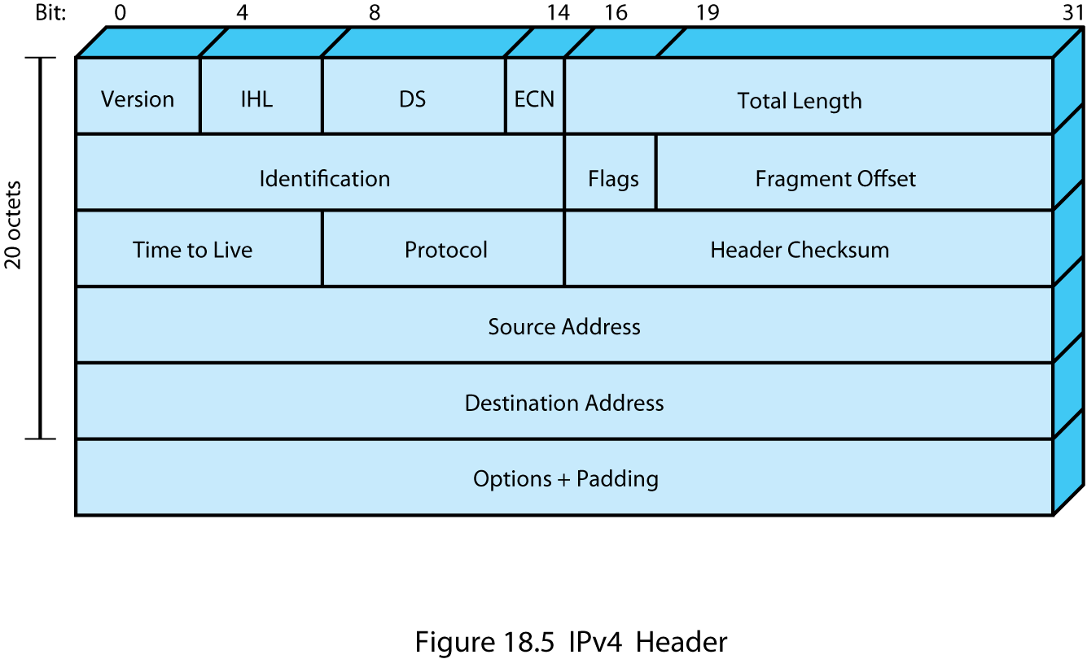
IPv4 Header
Notes:
The protocol between IP entities is best described with reference to the IP datagram format, shown in Figure 18.5. The fields are
Version (4 bits): Indicates version number, to allow evolution of the protocol; the value is 4.
Internet Header Length (IHL) (4 bits): Length of header in 32-bit words. The minimum value is five, for a minimum header length of 20 octets.
DS (8 bits): This field supports the Differentiated Service function, described in Chapter 20.
ECN (2 bits): The Explicit Congestion Notification field, defined in RFC 3168, enables routers to indicate to end nodes packets that are experiencing congestion, without the necessity of immediately dropping such packets. A value of 00 indicates a packet that is not using ECN. A value of 01 or 10 is set by the data sender to indicate that the end-points of the transport protocol are ECN-capable. A value of 11 is set by a router to indicate congestion has been encountered.
Total Length (16 bits): Total datagram length, including header plus data, in octets.
Identification (16 bits): A sequence number that, together with the source address, destination address, and user protocol, is intended to identify a datagram uniquely. Thus, this number should be unique for the datagram's source address, destination address, and user protocol for the time during which the datagram will remain in the internet.
Flags (3 bits): Only two of the bits are currently defined. The More bit is used for fragmentation and reassembly, as previously explained. The Don't Fragment bit prohibits fragmentation when set. This bit may be useful if it is known that the destination does not have the capability to reassemble fragments. However, if this bit is set, the datagram will be discarded if it exceeds the maximum size of an en route network. Therefore, if the bit is set, it may be advisable to use source routing to avoid networks with small maximum packet size.
Fragment Offset (13 bits): Indicates where in the original datagram this fragment belongs, measured in 64-bit units. This implies that fragments other than the last fragment must contain a data field that is a multiple of 64 bits in length.
Time to Live (8 bits): Specifies how long, in seconds, a datagram is allowed to remain in the internet. Every router that processes a datagram must decrease the TTL by at least one, so the TTL is similar to a hop count.
Protocol (8 bits): Indicates the next higher level protocol that is to receive the data field at the destination; thus, this field identifies the type of the next header in the packet after the IP header. Example values are TCP = 6; UDP = 17; ICMP = 1.
Header Checksum (16 bits): An error-detecting code applied to the header only. Because some header fields may change during transit (e.g., Time to Live, fragmentation-related fields), this is re-verified and recomputed at each router. The checksum is formed by taking the ones complement of the 16-bit ones complement addition of all 16-bit words in the header. For purposes of computation, the checksum field is itself initialized to a value of zero.
Source Address (32 bits): Coded to allow a variable allocation of bits to specify the network and the end system attached to the specified network, as discussed subsequently.
Destination Address (32 bits): Same characteristics as source address.
Options (variable): Encodes the options requested by the sending user.
Padding (variable): Used to ensure that the datagram header is a multiple of 32 bits in length.
Data (variable): The data field must be an integer multiple of 8 bits in length. The maximum length of the datagram (data field plus header) is 65,535 octets.
It should be clear how the IP services specified in the Send and Deliver primitives map into the fields of the IP datagram.
A discussion of this checksum is contained in Appendix Q.

Slide 15
IPv4 Header
Version – IP version (4 in this case).
HLEN – header length (measured in 32 bit word).
Total length – total length of the IP datagram, including header and data (in octets).
DS (Differentiated Service)– defines type of service needed (used for providing QoS), normally ignored by all routers.
Protocol – used to specify the higher level protocol used in the data area.
Header checksum – used for error control.
Time to live – specifies how long the datagram is supposed to stay in the network.

Slide 16
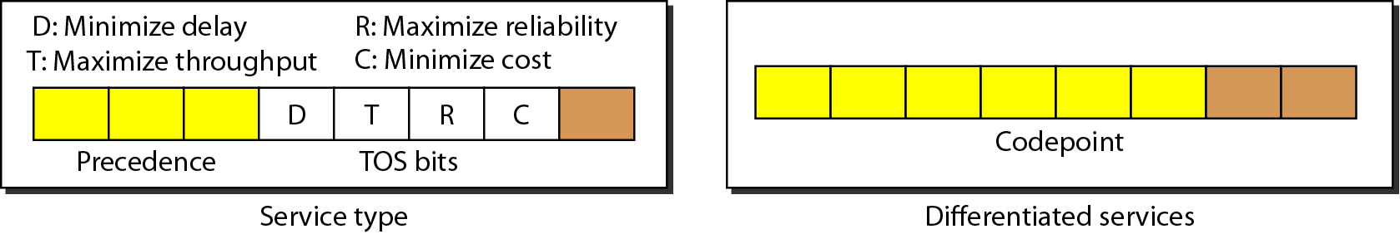
Service type or differentiated services

Slide 17
Differentiated Services
When 3 rightmost bits are zero, the three leftmost bits
are same as precedence.
When 3 rightmost bits are not all zeros, the 6 bits define
64 services based on priority assignment by the Internet
or local authorities.
Category | Codepoint | Assigning authority
1 | xxxxx0 | Internet
2 | xxxx11 | Local
3 | xxxx01 | Experimental

Slide 18
The total length field defines the total length of the datagram including the header.

Slide 19
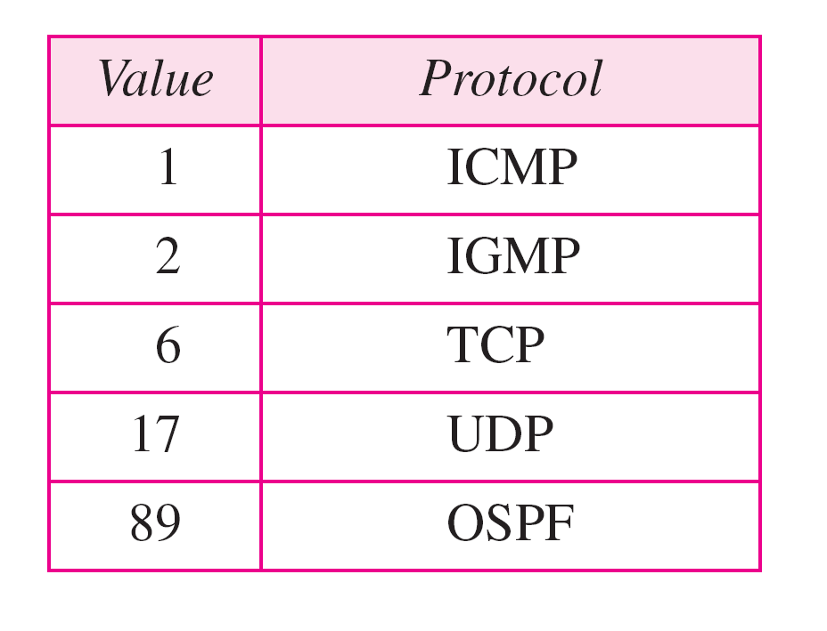
Protocol values

Slide 20
Some problems
An IPv4 packet has arrived with the first 8 bits as shown:
01000010
The receiver discards the packet. Why?
Solution
There is an error in this packet. The 4 leftmost bits (0100) show the version, which is correct. The next 4 bits (0010) show an invalid header length (2 × 4 = 8). The minimum number of bytes in the header must be 20. The packet has been corrupted in transmission.

Slide 21
Problems (cont’d)
In an IPv4 packet, the value of HLEN is 1000 in binary. How many bytes of options are being carried by this packet?
Solution
The HLEN value is 8, which means the total number of bytes in the header is 8 × 4, or 32 bytes. The first 20 bytes are the base header, the next 12 bytes are the options.

Slide 22
Problems (cont’d)
In an IPv4 packet, the value of HLEN is 5, and the value of the total length field is 0x0028. How many bytes of data are being carried by this packet?
Solution
The HLEN value is 5, which means the total number of bytes in the header is 5 × 4, or 20 bytes (no options). The total length is 40 bytes, which means the packet is carrying 20 bytes of data (40 − 20).

Slide 23
IP Parameters
source & destination addresses
protocol
type of Service
identification
don’t fragment indicator
time to live
data length
option data
user data
Notes:
The parameters associated with the two primitives are :
Source address: Internetwork address of sending IP entity.
Destination address: Internetwork address of destination IP entity.
Protocol: Recipient protocol entity (an IP user, such as TCP).
Type-of-service indicators: Used to specify the treatment of the data unit in its transmission through component networks.
Identification: Used in combination with the source and destination addresses and user protocol to identify the data unit uniquely. This parameter is needed for reassembly and error reporting.
Don't fragment identifier: Indicates whether IP can fragment data to accomplish delivery.
Time to live: Measured in seconds.
Data length: Length of data being transmitted.
Option data: Options requested by the IP user.
Data: User data to be transmitted.
The identification, don't fragment identifier, and time to live parameters are present in the Send primitive but not in the Deliver primitive. These three parameters provide instructions to IP that are not of concern to the recipient IP user.

Slide 24
IP Options
security
source routing
route recording
stream identification
timestamping
Notes:
The options parameter allows for future extensibility and for inclusion of parameters that are usually not invoked. The currently defined options are
Security: Allows a security label to be attached to a datagram.
Source routing: A sequenced list of router addresses that specifies the route to be followed. Routing may be strict (only identified routers may be visited) or loose (other intermediate routers may be visited).
Route recording: A field is allocated to record the sequence of routers visited by the datagram.
Stream identification: Names reserved resources used for stream service. This service provides special handling for volatile periodic traffic (e.g., voice).
Timestamping: The source IP entity and some or all intermediate routers add a timestamp (precision to milliseconds) to the data unit as it goes by.

Slide 25
Datagram Lifetime
datagrams could loop indefinitely
consumes resources
transport protocol may need upper bound on lifetime of a datagram
can mark datagram with lifetime
when lifetime expires, datagram discarded
Notes:
If dynamic or alternate routing is used, the potential exists for a datagram to loop indefinitely through the internet. This is undesirable for two reasons. First, an endlessly circulating datagram consumes resources. Second, we will see in Stallings DCC9e Chapter 22 that a transport protocol may depend on the existence of an upper bound on datagram lifetime. To avoid these problems, each datagram can be marked with a lifetime. Once the lifetime expires, the datagram is discarded.
A simple way to implement lifetime is to use a hop count. Each time that a datagram passes through a router, the count is decremented. Alternatively, the lifetime could be a true measure of time. This requires that the routers must somehow know how long it has been since the datagram or fragment last crossed a router, to know by how much to decrement the lifetime field. This would seem to require some global clocking mechanism. The advantage of using a true time measure is that it can be used in the reassembly algorithm, described next.

Slide 26
Fragmentation and Re-assembly
protocol exchanges data between two entities
lower-level protocols may need to break data up into smaller blocks, called fragmentation
reasons for fragmentation:
network only accepts blocks of a certain size
more efficient error control & smaller retransmission units
fairer access to shared facilities
smaller buffers
disadvantages:
smaller buffers
more interrupts & processing time
Notes:
The Internet Protocol accepts a block of data from a higher-layer protocol, such as TCP or UDP, and may divide this block in to multiple blocks of some smaller bounded size to form multiple IP packets. This process is called fragmentation.
There are a number of motivations for fragmentation, depending on the context. Among the typical reasons for fragmentation:
The communications network may only accept blocks of data up to a certain size. For example, an ATM network is limited to blocks of 53 octets; Ethernet imposes a maximum size of 1526 octets.
Error control may be more efficient with a smaller PDU size. With smaller PDUs, fewer bits need to be retransmitted when a PDU suffers an error.
More equitable access to shared transmission facilities, with shorter delay, can be provided. For example, without a maximum block size, one station could monopolize a multipoint medium.
A smaller PDU size may mean that receiving entities can allocate smaller buffers.
An entity may require that data transfer comes to some sort of "closure" from time to time, for checkpoint and restart/recovery operations.
There are several disadvantages to fragmentation that argue for making PDUs as large as possible:
Because each PDU contains a certain amount of control information, smaller blocks have a greater percentage of overhead.
PDU arrival may generate an interrupt that must be serviced. Smaller blocks result in more interrupts.
More time is spent processing smaller, more numerous PDUs.

Slide 27
Fragmentation and Re-assembly
issue of when to re-assemble
at destination
packets get smaller as data traverses internet
intermediate re-assembly
need large buffers at routers
buffers may fill with fragments
all fragments must go through same router
Notes:
If datagrams can be fragmented (perhaps more than once) in the course of their travels, the question arises as to where they should be reassembled. The easiest solution is to have reassembly performed at the destination only. The principal disadvantage of this approach is that fragments can only get smaller as data move through the internet. This may impair the efficiency of some networks. However, if intermediate router reassembly is allowed, the following disadvantages result:
1. Large buffers are required at routers, and there is the risk that all of the buffer space will be used up storing partial datagrams.
2. All fragments of a datagram must pass through the same router. This inhibits the use of dynamic routing.

Slide 28
IP Fragmentation
IP re-assembles at destination only
uses fields in header
Data Unit Identifier (ID)
identifies end system originated datagram
Data length
length of user data in octets
Offset
position of fragment of user data in original datagram
in multiples of 64 bits (8 octets)
indicates that this is not the last fragment
More flag
Notes:
In IP, datagram fragments are reassembled at the destination end system. The IP fragmentation technique uses the following information in the IP header:
Data Unit Identifier (ID)
Data Length
Offset
More Flag
The ID is a means of uniquely identifying an end-system-originated datagram. In IP, it consists of the source and destination addresses, a number that corresponds to the protocol layer that generated the data (e.g., TCP), and an identification supplied by that protocol layer. The Data Length is the length of the user data field in octets, and the Offset is the position of a fragment of user data in the data field of the original datagram, in multiples of 64 bits.
The source end system creates a datagram with a Data Length equal to the entire length of the data field, with Offset = 0, and a More Flag set to 0 (false). To fragment a long datagram into two pieces, an IP module in a router performs the following tasks:
1. Create two new datagrams and copy the header fields of the incoming datagram into both.
2. Divide the incoming user data field into two portions along a 64-bit boundary (counting from the beginning), placing one portion in each new datagram. The first portion must be a multiple of 64 bits (8 octets).
3. Set the Data Length of the first new datagram to the length of the inserted data, and set More Flag to 1 (true). The Offset field is unchanged.
4. Set the Data Length of the second new datagram to the length of the inserted data, and add the length of the first data portion divided by 8 to the Offset field. The More Flag remains the same.
To reassemble a datagram, there must be sufficient buffer space at the reassembly point. As fragments with the same ID arrive, their data fields are inserted in the proper position in the buffer until the entire data field is reassembled, which is achieved when a contiguous set of data exists starting with an Offset of zero and ending with data from a fragment with a false More Flag.
One eventuality that must be dealt with is that one or more of the fragments may not get through; the IP service does not guarantee delivery. Some method is needed to decide when to abandon a reassembly effort to free up buffer space. Two approaches are commonly used. First, assign a reassembly lifetime to the first fragment to arrive. This is a local, real-time clock assigned by the reassembly function and decremented while the fragments of the original datagram are being buffered. If the time expires prior to complete reassembly, the received fragments are discarded. A second approach is to make use of the datagram lifetime, which is part of the header of each incoming fragment. The lifetime field continues to be decremented by the reassembly function; as with the first approach, if the lifetime expires prior to complete reassembly, the received fragments are discarded.

Slide 29
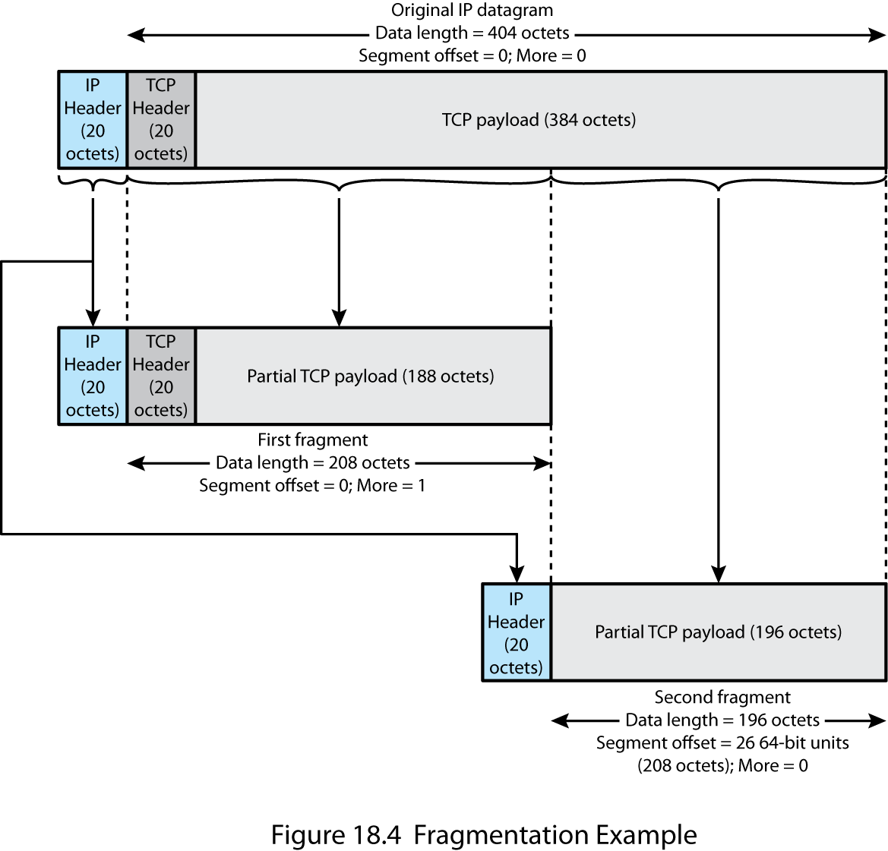
Fragmentation Example
Notes:
Stallings DCC9e Figure 18.4

Slide 30
Fragmentation fields in IPv4 Header
The field Identification, Flags and Fragment Offset are used to control fragmentation and reassembly.
Identification – unique integer that identifies the datagram, copied into each fragment header.
Fragment Offset – specifies the offset in the original datagram of the data being carried in the fragment.
Flags – 1st bit is reserved, 2nd control bit is “do not fragment”. The lower order bits are “more fragments”. If “more fragments” bit is 0, the router knows that is the last fragment.

Slide 31

Flags used in fragmentation

Slide 32
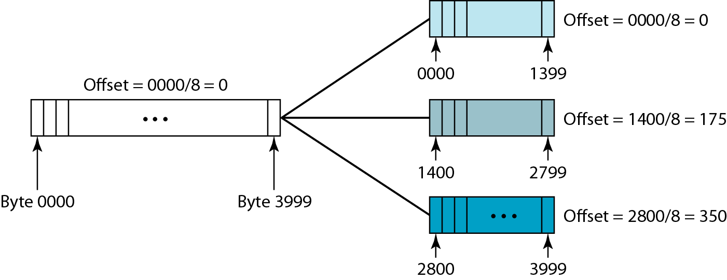
Fragmentation example

Slide 33
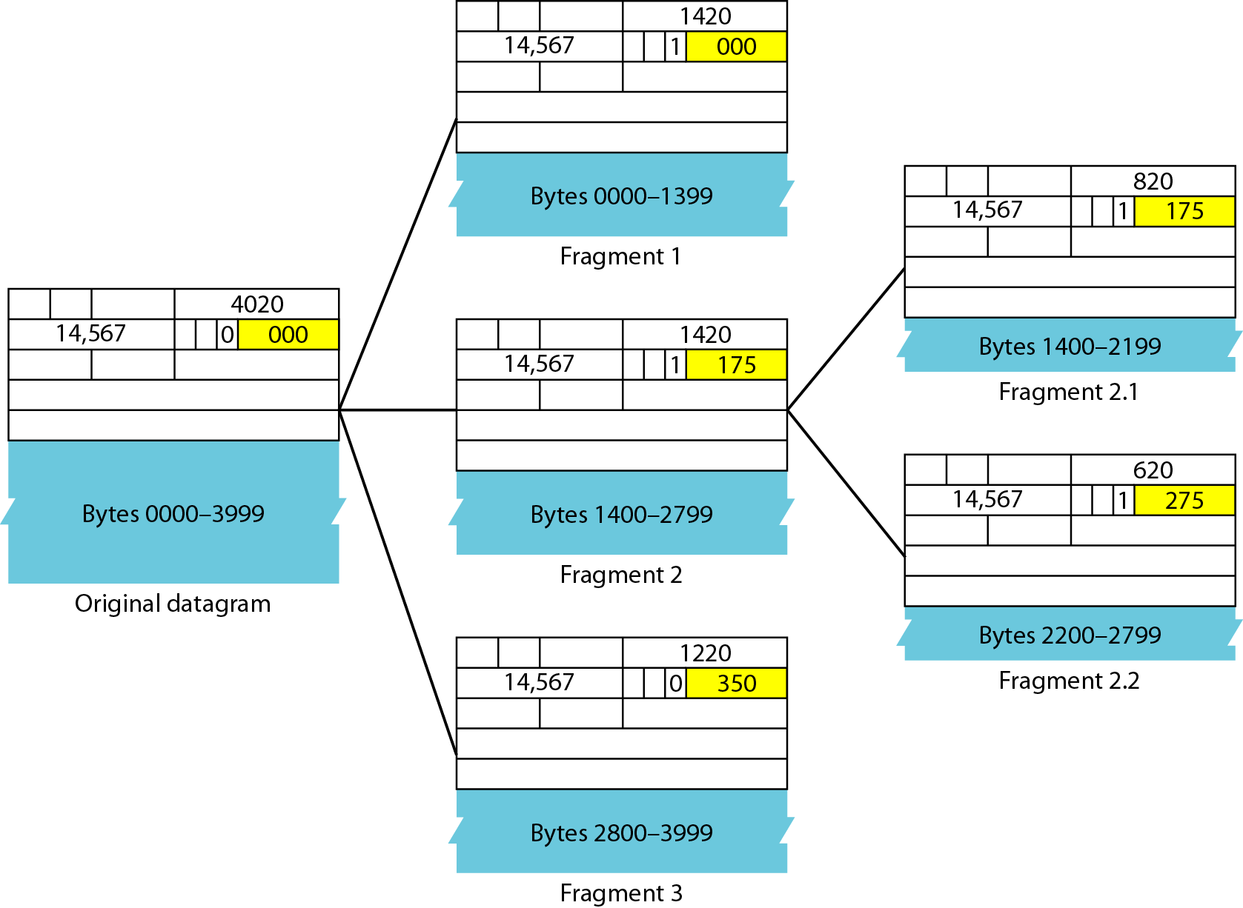
Detailed fragmentation example

Slide 34
Some problems
A packet has arrived with an M bit value of 0. Is this the first fragment, the last fragment, or a middle fragment? Do we know if the packet was fragmented?
If the M bit is 0, it means that there are no more fragments; the fragment is the last one. However, we cannot say if the original packet was fragmented or not. A non-fragmented packet is considered the last fragment.

Slide 35
Problems (cont’d)
A packet has arrived with an M bit value of 1. Is this the first fragment, the last fragment, or a middle fragment? Do we know if the packet was fragmented?
If the M bit is 1, it means that there is at least one more fragment. This fragment can be the first one or a middle one, but not the last one. We don’t know if it is the first one or a middle one; we need more information (the value of the fragmentation offset).

Slide 36
Problems (cont’d)
A packet has arrived with an M bit value of 1 and a fragmentation offset value of 0. Is this the first fragment, the last fragment, or a middle fragment?
Because the M bit is 1, it is either the first fragment or a middle one. Because the offset value is 0, it is the first fragment.

Slide 37
Problems (cont’d)
A packet has arrived in which the offset value is 100. What is the number of the first byte? Do we know the number of the last byte?
To find the number of the first byte, we multiply the offset value by 8. This means that the first byte number is 800. We cannot determine the number of the last byte unless we know the length.

Slide 38
Problems (cont’d)
A packet has arrived in which the offset value is 100, the value of HLEN is 5, and the value of the total length field is 100. What are the numbers of the first byte and the last byte?
The first byte number is 100 × 8 = 800. The total length is 100 bytes, and the header length is 20 bytes (5 × 4), which means that there are 80 bytes in this datagram. If the first byte number is 800, the last byte number must be 879.

Slide 39
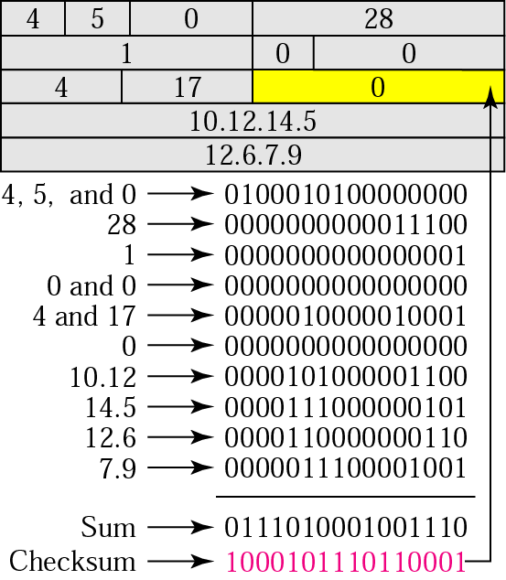
Example of Checksum Calculation
The header is divided into 16-bit sections. All the sections are added and the sum is complemented. The result is inserted in the checksum field.

Slide 40
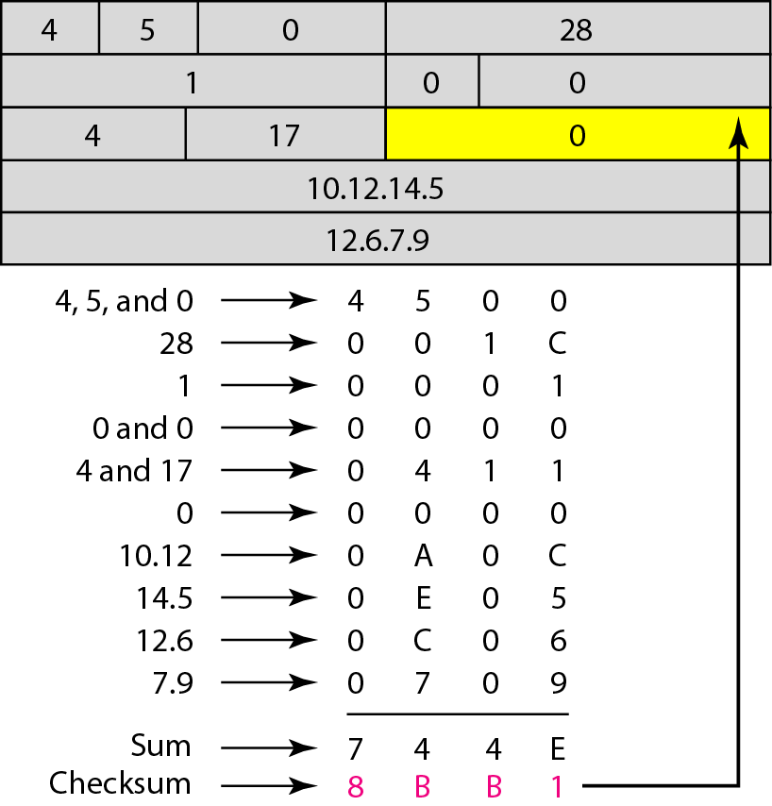
Example of checksum calculation in Hex

Slide 41
Error and Flow Control
Error control
discarded datagram identification is needed
reasons for discarded datagrams include:
lifetime expiration
congestion
FCS error
Flow control
allows routers to limit the rate they receive data
send flow control packets requesting reduced data flow
Notes:
The internetwork facility does not guarantee successful delivery of every datagram. When a datagram is discarded by a router, the router should attempt to return some information to the source, if possible. The source Internet Protocol entity may use this information to modify its transmission strategy and may notify higher layers. To report that a specific datagram has been discarded, some means of datagram identification is needed. Such identification is discussed in the next section.
Datagrams may be discarded for a number of reasons, including lifetime expiration, congestion, and FCS error. In the latter case, notification is not possible because the source address field may have been damaged.
Internet flow control allows routers and/or receiving stations to limit the rate at which they receive data. For the connectionless type of service we are describing, flow control mechanisms are limited. The best approach would seem to be to send flow control packets, requesting reduced data flow, to other routers and source stations. We will see one example of this with Internet Control Message Protocol, discussed in the next section.

Slide 42
Internet Control Message Protocol (ICMP)
RFC 792
transfer messages from routers and hosts to hosts
provides feedback about problems
datagram cannot reach its destination
router does not have buffer capacity to forward
router can send traffic on a shorter route
encapsulated in IP datagram
hence not reliable
Notes:
The IP standard specifies that a compliant implementation must also implement ICMP (RFC 792). ICMP provides a means for transferring messages from routers and other hosts to a host. In essence, ICMP provides feedback about problems in the communication environment. Examples of its use are when a datagram cannot reach its destination, when the router does not have the buffering capacity to forward a datagram, and when the router can direct the station to send traffic on a shorter route. In most cases, an ICMP message is sent in response to a datagram, either by a router along the datagram's path or by the intended destination host.
Although ICMP is, in effect, at the same level as IP in the TCP/IP architecture, it is a user of IP. An ICMP message is constructed and then passed down to IP, which encapsulates the message with an IP header and then transmits the resulting datagram in the usual fashion. Because ICMP messages are transmitted in IP datagrams, their delivery is not guaranteed and their use cannot be considered reliable.

Slide 43
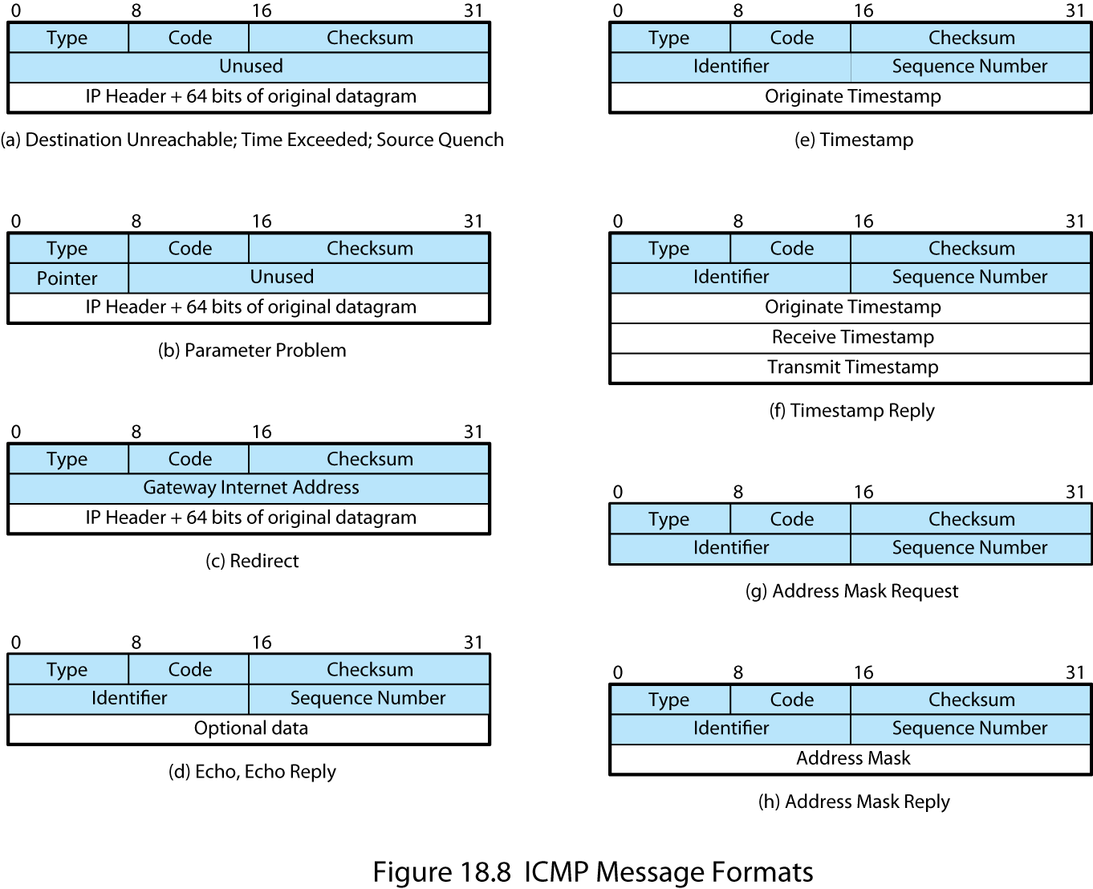
ICMP Message Format
Notes:
Stallings DCC9e Figure 18.8 shows the format of the various ICMP message types. An ICMP message starts with a 64-bit header consisting of the following:
Type (8 bits): Specifies the type of ICMP message.
Code (8 bits): Used to specify parameters of the message that can be encoded in one or a few bits.
Checksum (16 bits): Checksum of the entire ICMP message. This is the same checksum algorithm used for IP.
Parameters (32 bits): Used to specify more lengthy parameters.
These fields are generally followed by additional information fields that further specify the content of the message.

Slide 44

Common ICMP Messages
destination unreachable
time exceeded
parameter problem
source quench
redirect
echo & echo reply
timestamp & timestamp reply
address mask request & reply
Notes:
In those cases in which the ICMP message refers to a prior datagram, the information field includes the entire IP header plus the first 64 bits of the data field of the original datagram. This enables the source host to match the incoming ICMP message with the prior datagram. The reason for including the first 64 bits of the data field is that this will enable the IP module in the host to determine which upper-level protocol or protocols were involved. In particular, the first 64 bits would include a portion of the TCP header or other transport-level header.
The destination unreachable message covers a number of contingencies. A router may return this message if it does not know how to reach the destination network. In some networks, an attached router may be able to determine if a particular host is unreachable and returns the message. The destination host itself may return this message if the user protocol or some higher-level service access point is unreachable. This could happen if the corresponding field in the IP header was set incorrectly. If the datagram specifies a source route that is unusable, a message is returned. Finally, if a router must fragment a datagram but the Don't Fragment flag is set, the datagram is discarded and a message is returned.
A router will return a time exceeded message if the lifetime of the datagram expires. A host will send this message if it cannot complete reassembly within a time limit.
A syntactic or semantic error in an IP header will cause a parameter problem message to be returned by a router or host. For example, an incorrect argument may be provided with an option. The Parameter field contains a pointer to the octet in the original header where the error was detected.
The source quench message provides a rudimentary form of flow control. Either a router or a destination host may send this message to a source host, requesting that it reduce the rate at which it is sending traffic to the internet destination. On receipt of a source quench message, the source host should cut back the rate at which it is sending traffic to the specified destination until it no longer receives source quench messages. The source quench message can be used by a router or host that must discard datagrams because of a full buffer. In that case, the router or host will issue a source quench message for every datagram that it discards. In addition, a system may anticipate congestion and issue source quench messages when its buffers approach capacity. In that case, the datagram referred to in the source quench message may well be delivered. Thus, receipt of a source quench message does not imply delivery or nondelivery of the corresponding datagram.
A router sends a redirect message to a host on a directly connected router to advise the host of a better route to a particular destination. The following is an example, using Figure 18.7. Router R1 receives a datagram from host C on network Y, to which R1 is attached. R1 checks its routing table and obtains the address for the next router, R2, on the route to the datagram's internet destination network, Z. Because R2 and the host identified by the internet source address of the datagram are on the same network, R1 sends a redirect message to C. The redirect message advises the host to send its traffic for network Z directly to router R2, because this is a shorter path to the destination. The router forwards the original datagram to its internet destination (via R2). The address of R2 is contained in the parameter field of the redirect message.
The echo and echo reply messages provide a mechanism for testing that communication is possible between entities. The recipient of an echo message is obligated to return the message in an echo reply message. An identifier and sequence number are associated with the echo message to be matched in the echo reply message. The identifier might be used like a service access point to identify a particular session, and the sequence number might be incremented on each echo request sent.
The timestamp and timestamp reply messages provide a mechanism for sampling the delay characteristics of the internet. The sender of a timestamp message may include an identifier and sequence number in the parameters field and include the time that the message is sent (originate timestamp). The receiver records the time it received the message and the time that it transmits the reply message in the timestamp reply message. If the timestamp message is sent using strict source routing, then the delay characteristics of a particular route can be measured.
The address mask request and address mask reply messages are useful in an environment that includes subnets. The address mask request and reply messages allow a host to learn the address mask for the LAN to which it connects. The host broadcasts an address mask request message on the LAN. The router on the LAN responds with an address mask reply message that contains the address mask.

Slide 45
Address Resolution Protocol (ARP)
need MAC address to send to LAN host
manual
ARP (RFC 826) provides dynamic IP to Ethernet address mapping
source broadcasts ARP request
included in network address
use central directory
use address resolution protocol
destination replies with ARP response
Notes:
Earlier in this chapter, we referred to the concepts of a global address (IP address) and an address that conforms to the addressing scheme of the network to which a host is attached (subnetwork address). For a local area network, the latter address is a MAC address, which provides a physical address for a host port attached to the LAN. Clearly, to deliver an IP datagram to a destination host, a mapping must be made from the IP address to the subnetwork address for that last hop. If a datagram traverses one or more routers between source and destination hosts, then the mapping must be done in the final router, which is attached to the same subnetwork as the destination host. If a datagram is sent from one host to another on the same subnetwork, then the source host must do the mapping. In the following discussion, we use the term system to refer to the entity that does the mapping.
For mapping from an IP address to a subnetwork address, a number of approaches are possible, including
Each system can maintain a local table of IP addresses and matching subnetwork addresses for possible correspondents. This approach does not accommodate easy and automatic additions of new hosts to the subnetwork.
The subnetwork address can be a subset of the network portion of the IP address. However, the entire internet address is 32 bits long and for most subnetwork types (e.g., Ethernet) the host address field is longer than 32 bits.
A centralized directory can be maintained on each subnetwork that contains the IP-subnet address mappings. This is a reasonable solution for many networks.
An address resolution protocol can be used. This is a simpler approach than the use of a centralized directory and is well suited to LANs.
RFC 826 defines an Address Resolution Protocol (ARP), which allows dynamic distribution of the information needed to build tables to translate an IP address A into a 48-bit Ethernet address; the protocol can be used for any broadcast network. ARP exploits the broadcast property of a LAN; namely, that a transmission from any device on the network is received by all other devices on the network. ARP works as follows:
1. Each system on the LAN maintains a table of known IP-subnetwork address mappings.
2. When a subnetwork address is needed for an IP address, and the mapping is not found in the system's table, the system uses ARP directly on top of the LAN protocol (e.g., IEEE 802) to broadcast a request. The broadcast message contains the IP address for which a subnetwork address is needed.
3. Other hosts on the subnetwork listen for ARP messages and reply when a match occurs. The reply includes both the IP and subnetwork addresses of the replying host.
4. The original request includes the requesting host's IP address and subnetwork address. Any interested host can copy this information into its local table, avoiding the need for later ARP messages.
5. The ARP message can also be used simply to broadcast a host's IP address and subnetwork address, for the benefit of others on the subnetwork.

Slide 46
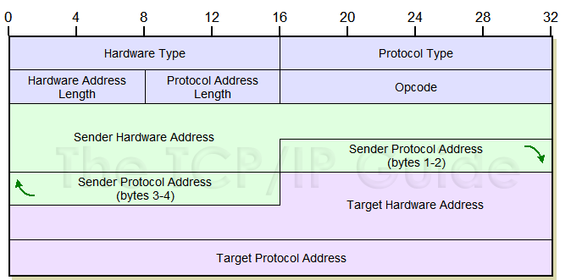
ARP Message Format

Slide 47
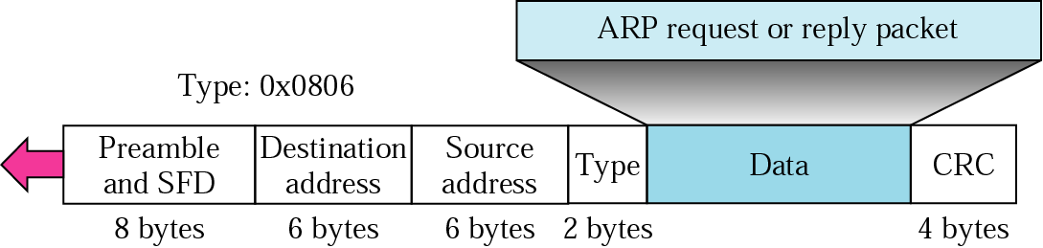
Encapsulation of ARP Packet

Slide 48
IP Versions
IP v 1-3 defined and replaced
IP v4 - current version
IP v5 - streams protocol
IP v6 - replacement for IP v4
during development it was called IPng (IP Next Generation)
Notes:
The Internet Protocol (IP) has been the foundation of the Internet and virtually all multivendor private internetworks. This protocol is reaching the end of its useful life and a new protocol, known as IPv6 (IP version 6), has been defined to ultimately replace IP.
We first look at the motivation for developing a new version of IP and then examine some of its details.
The currently deployed version of IP is IP version 4; previous versions of IP (1 through 3) were successively defined and replaced to reach IPv4. Version 5 is the number assigned to the Stream Protocol, a connection-oriented internet-layer protocol. Hence the use of the label version 6.

Slide 49
Why Change IP?
address space exhaustion:
two level addressing (network and host) wastes space
network addresses used even if not connected
growth of networks and the Internet
extended use of TCP/IP
single address per host
requirements for new types of service
address configuration
routing flexibility
traffic support
Notes:
The driving motivation for the adoption of a new version of IP was the limitation imposed by the 32-bit address field in IPv4. With a 32-bit address field, it is possible in principle to assign 232 different addresses, which is over 4 billion possible addresses. One might think that this number of addresses was more than adequate to meet addressing needs on the Internet. However, in the late 1980s it was perceived that there would be a problem, and this problem began to manifest itself in the early 1990s. Reasons for the inadequacy of 32-bit addresses include the following:
The two-level structure of the IP address (network number, host number) is convenient but wasteful of the address space. Once a network number is assigned to a network, all of the host-number addresses for that network number are assigned to that network. The address space for that network may be sparsely used, but as far as the effective IP address space is concerned, if a network number is used, then all addresses within the network are used.
The IP addressing model generally requires that a unique network number be assigned to each IP network whether or not it is actually connected to the Internet.
Networks are proliferating rapidly. Most organizations boast multiple LANs, not just a single LAN system. Wireless networks have rapidly assumed a major role. The Internet itself has grown explosively for years.
Growth of TCP/IP usage into new areas will result in a rapid growth in the demand for unique IP addresses. Examples include using TCP/IP to interconnect electronic point-of-sale terminals and for cable television receivers.
Typically, a single IP address is assigned to each host. A more flexible arrangement is to allow multiple IP addresses per host. This, of course, increases the demand for IP addresses.
So the need for an increased address space dictated that a new version of IP was needed. In addition, IP is a very old protocol, and new requirements in the areas of address configuration, routing flexibility, and traffic support had been defined.

Slide 50
IPv6 RFCs
RFC 1752 - Recommendations for the IP Next Generation Protocol
requirements
PDU formats
addressing, routing security issues
RFC 2460 - overall specification
RFC 4291 - addressing structure
Notes:
In response to these needs, the Internet Engineering Task Force (IETF) issued a call for proposals for a next generation IP (IPng) in July of 1992. A number of proposals were received, and by 1994 the final design for IPng emerged. A major milestone was reached with the publication of RFC 1752, "The Recommendation for the IP Next Generation Protocol," issued in January 1995. RFC 1752 outlines the requirements for IPng, specifies the PDU formats, and highlights the IPng approach in the areas of addressing, routing, and security. A number of other Internet documents defined details of the protocol, now officially called IPv6; these include an overall specification of IPv6 (RFC 2460), an RFC dealing with addressing structure of IPv6 (RFC 4291), and numerous others.

Slide 51
IPv6 Enhancements
expanded 128 bit address space
improved option mechanism
most not examined by intermediate routes
dynamic address assignment
increased addressing flexibility
anycast & multicast
support for resource allocation
labeled packet flows
Notes:
IPv6 includes the following enhancements over IPv4:
Expanded address space: IPv6 uses 128-bit addresses instead of the 32-bit addresses of IPv4. This is an increase of address space by a factor of 296. It has been pointed out [HIND95] that this allows on the order of 6 ´ 1023 unique addresses per square meter of the surface of the earth. Even if addresses are very inefficiently allocated, this address space seems inexhaustible.
Improved option mechanism: IPv6 options are placed in separate optional headers that are located between the IPv6 header and the transport-layer header. Most of these optional headers are not examined or processed by any router on the packet's path. This simplifies and speeds up router processing of IPv6 packets compared to IPv4 datagrams. It also makes it easier to add additional options.
Address auto configuration: This capability provides for dynamic assignment of IPv6 addresses.
Increased addressing flexibility: IPv6 includes the concept of an anycast address, for which a packet is delivered to just one of a set of nodes. The scalability of multicast routing is improved by adding a scope field to multicast addresses.
Support for resource allocation: IPv6 enables the labeling of packets belonging to a particular traffic flow for which the sender requests special handling. This aids in the support of specialized traffic such as real-time video.

Slide 52
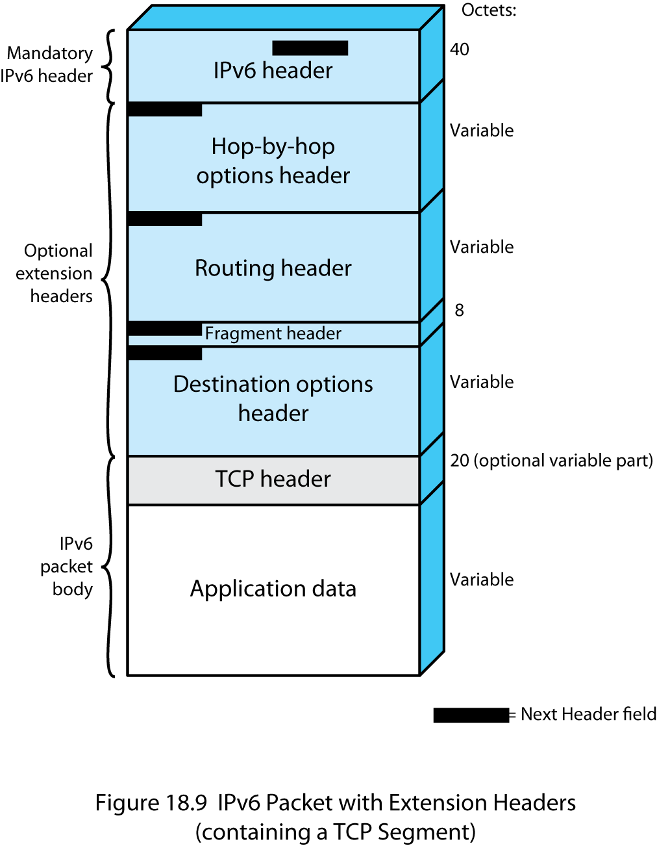
IPv6 PDU (Packet) Structure
Notes:
The only header that is required is referred to simply as the IPv6 header. This is of fixed size with a length of 40 octets, compared to 20 octets for the mandatory portion of the IPv4 header (Stallings DCC9e Figure 18.5). The following extension headers have been defined:
Hop-by-Hop Options header: Defines special options that require hop-by-hop processing
Routing header: Provides extended routing, similar to IPv4 source routing
Fragment header: Contains fragmentation and reassembly information
Authentication header: Provides packet integrity and authentication
Encapsulating Security Payload header: Provides privacy
Destination Options header: Contains optional information to be examined by the destination node
The IPv6 standard recommends that, when multiple extension headers are used, the IPv6 headers appear in the following order:
1. IPv6 header: Mandatory, must always appear first
2. Hop-by-Hop Options header
3. Destination Options header: For options to be processed by the first destination that appears in the IPv6 Destination Address field plus subsequent destinations listed in the Routing header
4. Routing header
5. Fragment header
6. Authentication header
7. Encapsulating Security Payload header
8. Destination Options header: For options to be processed only by the final destination of the packet
Stallings DCC9e Figure 18.9 shows an example of an IPv6 packet that includes an instance of each header, except those related to security. Note that the IPv6 header and each extension header include a Next Header field. This field identifies the type of the immediately following header. If the next header is an extension header, then this field contains the type identifier of that header. Otherwise, this field contains the protocol identifier of the upper-layer protocol using IPv6 (typically a transport-level protocol), using the same values as the IPv4 Protocol field. In Figure 18.9, the upper-layer protocol is TCP; thus, the upper-layer data carried by the IPv6 packet consist of a TCP header followed by a block of application data.
We first look at the main IPv6 header and then examine each of the extensions in turn.

Slide 53
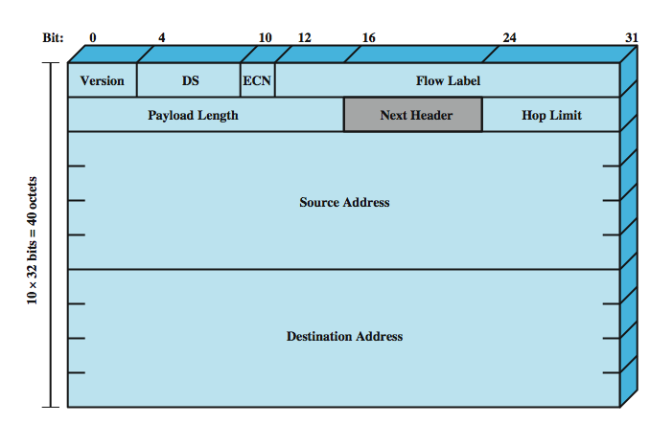
IP v6 Header
Notes:
The IPv6 header has a fixed length of 40 octets, consisting of the following fields (Stallings DCC9e Figure 18.10):
Version (4 bits): Internet protocol version number; the value is 6.
DS/ECN (8 bits): Available for use by originating nodes and/or forwarding routers for differentiated services and congestion functions, as described for the IPv4 DS/ECN field.
Flow Label (20 bits): May be used by a host to label those packets for which it is requesting special handling by routers within a network; discussed subsequently.
Payload Length (16 bits): Length of the remainder of the IPv6 packet following the header, in octets. In other words, this is the total length of all of the extension headers plus the transport-level PDU.
Next Header (8 bits): Identifies the type of header immediately following the IPv6 header; this will either be an IPv6 extension header or a higher-layer header, such as TCP or UDP.
Hop Limit (8 bits): The remaining number of allowable hops for this packet. The hop limit is set to some desired maximum value by the source and decremented by 1 by each node that forwards the packet. The packet is discarded if Hop Limit is decremented to zero. This is a simplification over the processing required for the Time to Live field of IPv4. The consensus was that the extra effort in accounting for time intervals in IPv4 added no significant value to the protocol. In fact, IPv4 routers, as a general rule, treat the Time to Live field as a hop limit field.
Source Address (128 bits): The address of the originator of the packet.
Destination Address (128 bits): The address of the intended recipient of the packet. This may not in fact be the intended ultimate destination if a Routing header is present, as explained subsequently.
Although the IPv6 header is longer than the mandatory portion of the IPv4 header (40 octets versus 20 octets), it contains fewer fields (8 versus 12). Thus, routers have less processing to do per header, which should speed up routing.

Slide 54
IP v6 Flow Label
related sequence of packets
special handling
identified by source and destination address + flow label
router treats flow as sharing attributes
may treat flows differently
alternative to including all information in every header
have requirements on flow label processing
Notes:
RFC 3697 defines a flow as a sequence of packets sent from a particular source to a particular (unicast, anycast, or multicast) destination for which the source desires special handling by the intervening routers. A flow is uniquely identified by the combination of a source address, destination address, and a nonzero 20-bit flow label. Thus, all packets that are to be part of the same flow are assigned the same flow label by the source.
From the source's point of view, a flow typically will be a sequence of packets that are generated from a single application instance at the source and that have the same transfer service requirements. A flow may comprise a single TCP connection or even multiple TCP connections; an example of the latter is a file transfer application, which could have one control connection and multiple data connections. A single application may generate a single flow or multiple flows. An example of the latter is multimedia conferencing, which might have one flow for audio and one for graphic windows, each with different transfer requirements in terms of data rate, delay, and delay variation.
From the router's point of view, a flow is a sequence of packets that share attributes that affect how these packets are handled by the router. These include path, resource allocation, discard requirements, accounting, and security attributes. The router may treat packets from different flows differently in a number of ways, including allocating different buffer sizes, giving different precedence in terms of forwarding, and requesting different quality of service from networks.
There is no special significance to any particular flow label. Instead the special handling to be provided for a packet flow must be declared in some other way. For example, a source might negotiate or request special handling ahead of time from routers by means of a control protocol, or at transmission time by information in one of the extension headers in the packet, such as the Hop-by-Hop Options header. Examples of special handling that might be requested include some sort of non-default quality of service and some form of real-time service.
In principle, all of a user's requirements for a particular flow could be defined in an extension header and included with each packet. If we wish to leave the concept of flow open to include a wide variety of requirements, this design approach could result in very large packet headers. The alternative, adopted for IPv6, is the flow label, in which the flow requirements are defined prior to flow commencement and a unique flow label is assigned to the flow. In this case, the router must save flow requirement information about each flow.
The following rules apply to the flow label:
1. Hosts or routers that do not support the Flow Label field must set the field to zero when originating a packet, pass the field unchanged when forwarding a packet, and ignore the field when receiving a packet.
2. All packets originating from a given source with the same nonzero Flow Label must have the same Destination Address, Source Address, Hop-by-Hop Options header contents (if this header is present), and Routing header contents (if this header is present). The intent is that a router can decide how to route and process the packet by simply looking up the flow label in a table and without examining the rest of the header.
3. The source assigns a flow label to a flow. New flow labels must be chosen (pseudo-) randomly and uniformly in the range 1 to 220 – 1, subject to the restriction that a source must not reuse a flow label for a new flow within the lifetime of the existing flow. The zero flow label is reserved to indicate that no flow label is being used.
This last point requires some elaboration. The router must maintain information about the characteristics of each active flow that may pass through it, presumably in some sort of table. To forward packets efficiently and rapidly, table lookup must be efficient. One alternative is to have a table with 220 (about 1 million) entries, one for each possible flow label; this imposes an unnecessary memory burden on the router. Another alternative is to have one entry in the table per active flow, include the flow label with each entry, and require the router to search the entire table each time a packet is encountered. This imposes an unnecessary processing burden on the router. Instead, most router designs are likely to use some sort of hash table approach. With this approach a moderate-sized table is used, and each flow entry is mapped into the table using a hashing function on the flow label. The hashing function might simply be the low-order few bits (say 8 or 10) of the flow label or some simple calculation on the 20 bits of the flow label. In any case, the efficiency of the hash approach typically depends on the flow labels being uniformly distributed over their possible range. Hence requirement number 3 in the preceding list.

Slide 55
IPv6 Addresses
128 bits long
assigned to interface
single interface may have multiple unicast addresses
three types of addresses:
unicast - single interface address
anycast - one of a set of interface addresses
multicast - all of a set of interfaces
Notes:
IPv6 addresses are 128 bits in length. Addresses are assigned to individual interfaces on nodes, not to the nodes themselves. A single interface may have multiple unique unicast addresses. Any of the unicast addresses associated with a node's interface may be used to uniquely identify that node.
The combination of long addresses and multiple addresses per interface enables improved routing efficiency over IPv4. In IPv4, addresses generally do not have a structure that assists routing, and therefore a router may need to maintain huge table of routing paths. Longer internet addresses allow for aggregating addresses by hierarchies of network, access provider, geography, corporation, and so on. Such aggregation should make for smaller routing tables and faster table lookups. The allowance for multiple addresses per interface would allow a subscriber that uses multiple access providers across the same interface to have separate addresses aggregated under each provider's address space.
IPv6 allows three types of addresses:
Unicast: An identifier for a single interface. A packet sent to a unicast address is delivered to the interface identified by that address.
Anycast: An identifier for a set of interfaces (typically belonging to different nodes). A packet sent to an anycast address is delivered to one of the interfaces identified by that address (the "nearest" one, according to the routing protocols' measure of distance).
Multicast: An identifier for a set of interfaces (typically belonging to different nodes). A packet sent to a multicast address is delivered to all interfaces identified by that address.

Slide 56
Hop-by-Hop Options
must be examined by every router
if unknown discard/forward handling is specified
next header
header extension length
options
Pad1
PadN
Jumbo payload
Router alert
Notes:
The Hop-by-Hop Options header carries optional information that, if present, must be examined by every router along the path. This header consists of (Figure 18.11a):
Next Header (8 bits): Identifies the type of header immediately following this header.
Header Extension Length (8 bits): Length of this header in 64-bit units, not including the first 64 bits.
Options: A variable-length field consisting of one or more option definitions. Each definition is in the form of three subfields: Option Type (8 bits), which identifies the option; Length (8 bits), which specifies the length of the Option Data field in octets; and Option Data, which is a variable-length specification of the option.
It is actually the lowest-order five bits of the Option Type field that are used to specify a particular option. The high-order two bits indicate that action to be taken by a node that does not recognize this option type, as follows:
00 - Skip over this option and continue processing the header.
01 - Discard the packet.
10 - Discard the packet and send an ICMP Parameter Problem message to the packet's Source Address, pointing to the unrecognized Option Type.
11 - Discard the packet and, only if the packet's Destination Address is not a multicast address, send an ICMP Parameter Problem message to the packet's Source Address, pointing to the unrecognized Option Type
The third highest-order bit specifies whether the Option Data field does not change (0) or may change (1) en route from source to destination. Data that may change must be excluded from authentication calculations, as discussed in Chapter 24.
These conventions for the Option Type field also apply to the Destination Options header.
Four hop-by-hop options have been specified so far:
Pad1: Used to insert one byte of padding into the Options area of the header.
PadN: Used to insert N bytes (N ≥ 2) of padding into the Options area of the header. The two padding options ensure that the header is a multiple of 8 bytes in length.
Jumbo payload: Used to send IPv6 packets with payloads longer than 65,535 octets. The Option Data field of this option is 32 bits long and gives the length of the packet in octets, excluding the IPv6 header. For such packets, the Payload Length field in the IPv6 header must be set to zero, and there must be no Fragment header. With this option, IPv6 supports packet sizes up to more than 4 billion octets. This facilitates the transmission of large video packets and enables IPv6 to make the best use of available capacity over any transmission medium.
Router alert: Informs the router that the contents of this packet is of interest to the router and to handle any control data accordingly. The absence of this option in an IPv6 datagram informs the router that the packet does not contain information needed by the router and hence can be safely routed without further packet parsing. Hosts originating IPv6 packets are required to include this option in certain circumstances. The purpose of this option is to provide efficient support for protocols such as RSVP (Chapter 20) that generate packets that need to be examined by intermediate routers for purposes of traffic control. Rather than requiring the intermediate routers to look in detail at the extension headers of a packet, this option alerts the router when such attention is required.

Slide 57
Fragmentation Header
fragmentation only allowed at source
no fragmentation at intermediate routers
node must perform path discovery to find smallest MTU of intermediate networks
set source fragments to match MTU
otherwise limit to 1280 octets
Notes:
In IPv6, fragmentation may only be performed by source nodes, not by routers along a packet's delivery path. To take full advantage of the internetworking environment, a node must perform a path discovery algorithm that enables it to learn the smallest maximum transmission unit (MTU) supported by any network on the path. With this knowledge, the source node will fragment, as required, for each given destination address. Otherwise the source must limit all packets to 1280 octets, which is the minimum MTU that must be supported by each network.
The fragment header consists of (Stallings DCC9e Figure 18.11b):
Next Header (8 bits): Identifies the type of header immediately following this header.
Reserved (8 bits): For future use.
Fragment Offset (13 bits): Indicates where in the original packet the payload of this fragment belongs, measured in 64-bit units. This implies that fragments (other than the last fragment) must contain a data field that is a multiple of 64 bits long.
Res (2 bits): Reserved for future use.
M Flag (1 bit): 1 = more fragments; 0 = last fragment.
Identification (32 bits): Intended to uniquely identify the original packet. The identifier must be unique for the packet's source address and destination address for the time during which the packet will remain in the internet. All fragments with the same identifier, source address, and destination address are reassembled to form the original packet.

Slide 58
Routing Header
contains a list of one or more intermediate nodes to be visited on the way to a packet’s destination
header includes
next header
Type 0 routing provides a list of addresses
initial destination address is first on list
header extension length
routing type
segments left
current destination address is next on list
final destination address will be last in list
Notes:
The Routing header contains a list of one or more intermediate nodes to be visited on the way to a packet's destination. All routing headers start with a 32-bit block consisting of four 8-bit fields, followed by routing data specific to a given routing type (Stallings DCC9e Figure 18.11c). The four 8-bit fields are:
Next Header: Identifies the type of header immediately following this header.
Header Extension Length: Length of this header in 64-bit units, not including the first 64 bits.
Routing Type: Identifies a particular Routing header variant. If a router does not recognize the Routing Type value, it must discard the packet.
Segments Left: Number of route segments remaining; that is, the number of explicitly listed intermediate nodes still to be visited before reaching the final destination.
The only specific routing header format defined in RFC 2460 is the Type 0 Routing header (Figure 18.11d). When using the Type 0 Routing header, the source node does not place the ultimate destination address in the IPv6 header. Instead, that address is the last address listed in the Routing header (Address[n] in Figure 18.11d), and the IPv6 header contains the destination address of the first desired router on the path. The Routing header will not be examined until the packet reaches the node identified in the IPv6 header. At that point, the IPv6 and Routing header contents are updated and the packet is forwarded. The update consists of placing the next address to be visited in the IPv6 header and decrementing the Segments Left field in the Routing header.

Slide 59
Destination Options Header
carries optional information for destination node
format same as hop-by-hop header
Notes:
Destination Options Header
The Destination Options header carries optional information that, if present, is examined only by the packet's destination node. The format of this header is the same as that of the Hop-by-Hop Options header (StallingsDCC9e Figure 18.11a).

Slide 60
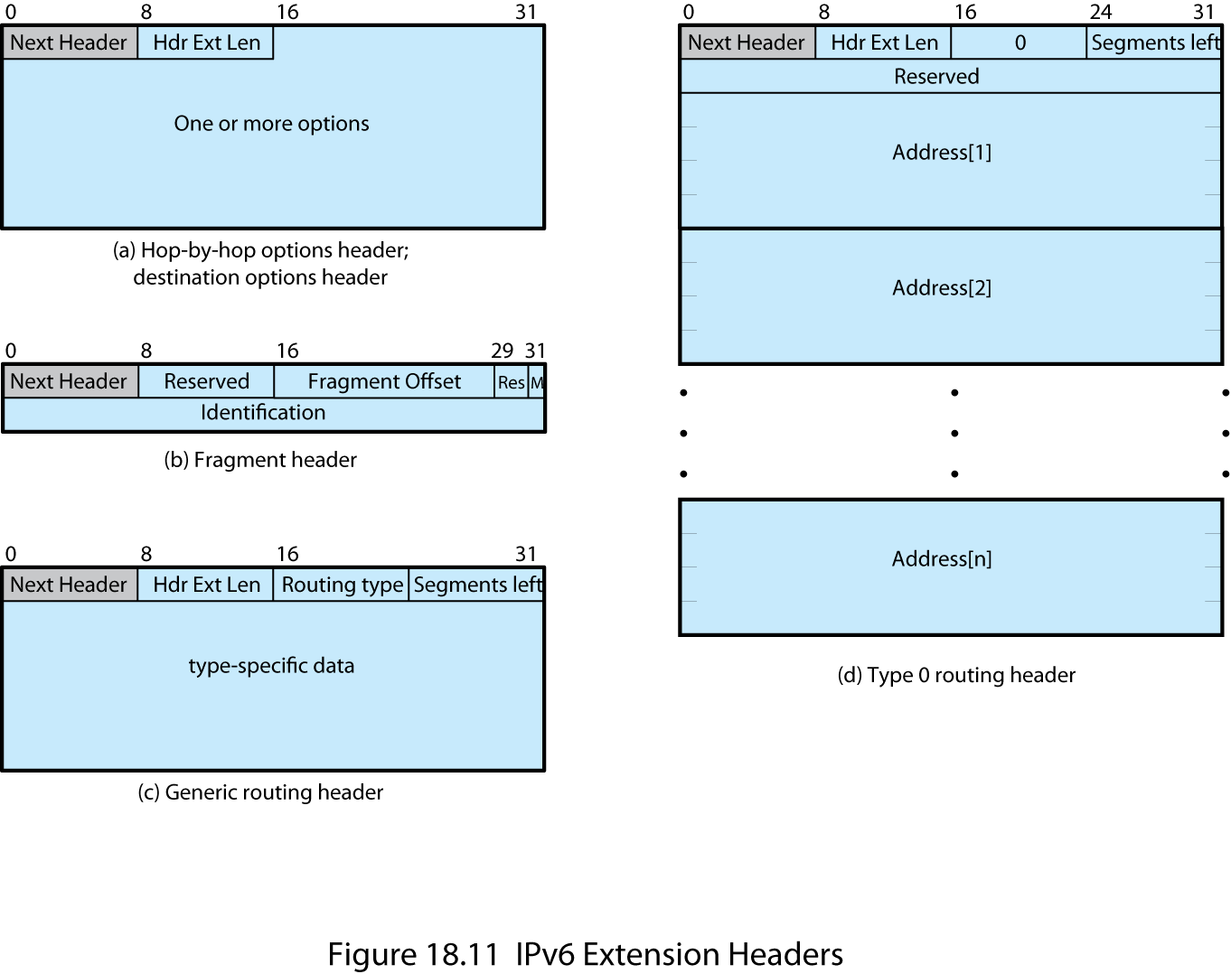
IPv6 Extension Headers
Notes:
Stallings DCC9e Figure 18.11 illustrates the IPv6 Extension Headers.

Slide 61
Virtual Private Network (VPN)
set of computers interconnected using an unsecure network
e.g. linking corporate LANs over Internet
using encryption & special protocols
to provide security
eavesdropping
entry point for unauthorized users
proprietary solutions are problematical
development of IPSec standard
Notes:
In today's distributed computing environment, the virtual private network (VPN) offers an attractive solution to network managers. In essence, a VPN consists of a set of computers that interconnect by means of a relatively unsecure network and that make use of encryption and special protocols to provide security. At each corporate site, workstations, servers, and databases are linked by one or more local area networks (LANs). The LANs are under the control of the network manager and can be configured and tuned for cost-effective performance. The Internet or some other public network can be used to interconnect sites, providing a cost savings over the use of a private network and offloading the wide area network management task to the public network provider. That same public network provides an access path for telecommuters and other mobile employees to log on to corporate systems from remote sites.
But the manager faces a fundamental requirement: security. Use of a public network exposes corporate traffic to eavesdropping and provides an entry point for unauthorized users. To counter this problem, the manager may choose from a variety of encryption and authentication packages and products. Proprietary solutions raise a number of problems. First, how secure is the solution? If proprietary encryption or authentication schemes are used, there may be little reassurance in the technical literature as to the level of security provided. Second is the question of compatibility. No manager wants to be limited in the choice of workstations, servers, routers, firewalls, and so on by a need for compatibility with the security facility. This is the motivation for the IP Security (IPsec) set of Internet standards.

Slide 62
IPSec
RFC 1636 (1994) identified security need
encryption and authentication necessary security features in IPv6
designed also for use with current IPv4
applications needing security include:
branch office connectivity
remote access over Internet
extranet and intranet connectivity for partners
electronic commerce security
Notes:
In 1994, the Internet Architecture Board (IAB) issued a report titled "Security in the Internet Architecture" (RFC 1636). The report stated the general consensus that the Internet needs more and better security and identified key areas for security mechanisms. Among these were the need to secure the network infrastructure from unauthorized monitoring and control of network traffic and the need to secure end-user-to-end-user traffic using authentication and encryption mechanisms.
To provide security, the IAB included authentication and encryption as necessary security features in the next-generation IP, which has been issued as IPv6. Fortunately, these security capabilities were designed to be usable both with the current IPv4 and the future IPv6. This means that vendors can begin offering these features now, and many vendors do now have some IPsec capability in their products. The IPsec specification now exists as a set of Internet standards.
IPsec provides the capability to secure communications across a LAN, across private and public WANs, and across the Internet. Examples of its use include:
Secure branch office connectivity over the Internet: A company can build a secure virtual private network over the Internet or over a public WAN. This enables a business to rely heavily on the Internet and reduce its need for private networks, saving costs and network management overhead.
Secure remote access over the Internet: An end user whose system is equipped with IP security protocols can make a local call to an Internet service provider (ISP) and gain secure access to a company network. This reduces the cost of toll charges for traveling employees and telecommuters.
Establishing extranet and intranet connectivity with partners: IPsec can be used to secure communication with other organizations, ensuring authentication and confidentiality and providing a key exchange mechanism.
Enhancing electronic commerce security: Even though some Web and electronic commerce applications have built-in security protocols, the use of IPsec enhances that security. IPsec guarantees that all traffic designated by the network administrator is both encrypted and authenticated, adding an additional layer of security to whatever is provided at the application layer.

Slide 63
IPSec Functions
authentication header
for authentication only
Encapsulating Security Payload (ESP)
for combined authentication/encryption
a key exchange function
manual or automated
VPNs usually need combined function
Notes:
IPsec provides three main facilities: an authentication-only function referred to as Authentication Header (AH), a combined authentication/encryption function called Encapsulating Security Payload (ESP), and a key exchange function. For VPNs, both authentication and encryption are generally desired, because it is important both to (1) assure that unauthorized users do not penetrate the virtual private network and (2) assure that eavesdroppers on the Internet cannot read messages sent over the virtual private network. Because both features are generally desirable, most implementations are likely to use ESP rather than AH. The key exchange function allows for manual exchange of keys as well as an automated scheme.

Slide 64
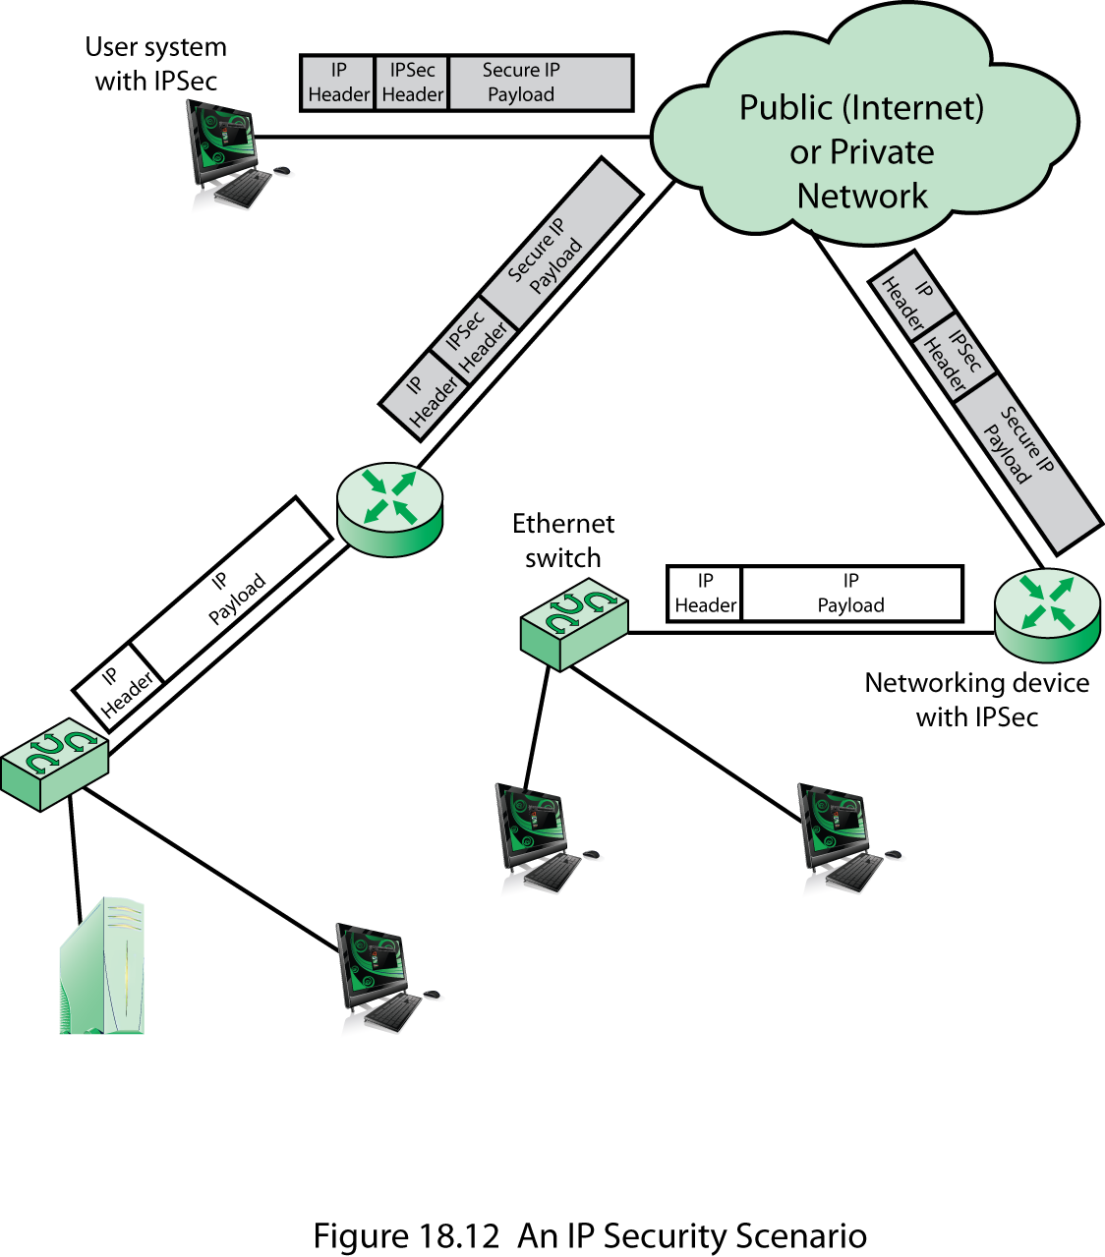
IP Security Scenario
Notes:
Stallings DCC9e Figure 18.12 is a typical scenario of IPsec usage.

Slide 65
Benefits of IPsec
provides strong security for external traffic
resistant to bypass
below transport layer hence transparent to applications
can be transparent to end users
can provide security for individual users if needed
Notes:
When IPsec is implemented in a firewall or router, it provides strong security that can be applied to all traffic crossing the perimeter. Traffic within a company or workgroup does not incur the overhead of security-related processing.
IPsec in a firewall is resistant to bypass if all traffic from the outside must use IP and the firewall is the only means of entrance from the Internet into the organization.
IPsec is below the transport layer (TCP, UDP) and so is transparent to applications. There is no need to change software on a user or server system when IPsec is implemented in the firewall or router. Even if IPsec is implemented in end systems, upper-layer software, including applications, is not affected.
IPsec can be transparent to end users. There is no need to train users on security mechanisms, issue keying material on a per-user basis, or revoke keying material when users leave the organization.
IPsec can provide security for individual users if needed. This is useful for offsite workers and for setting up a secure virtual subnetwork within an organization for sensitive applications.

